Slide 1

Data 606: Capstone Project
Title : Data-Driven Fare and Duration prediction with Peak hour classification for NYC Taxi Trips
Professor:
Dr. Unal 'Zak' Sakoglu
Presented By:
Group D
Team Members:
-Tejaswini Penneni
-Shiva Shankar Kanike
-Soniya Koduru

Slide 2
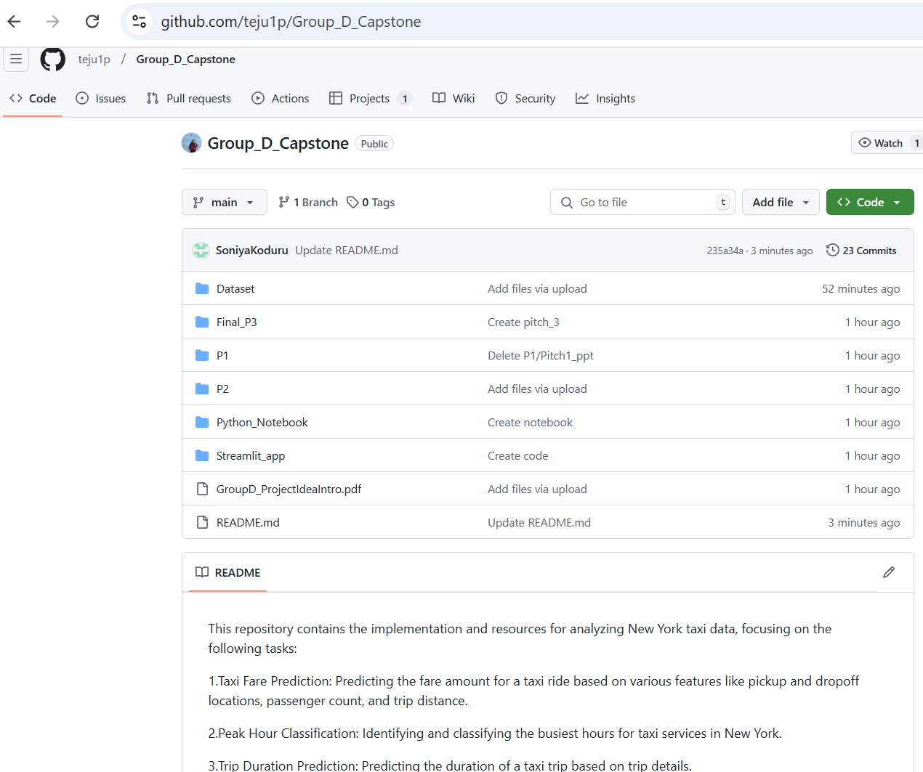
Github Snapshot
Git Account: https://github.com/teju1p/Group_D_Capstone

Slide 3
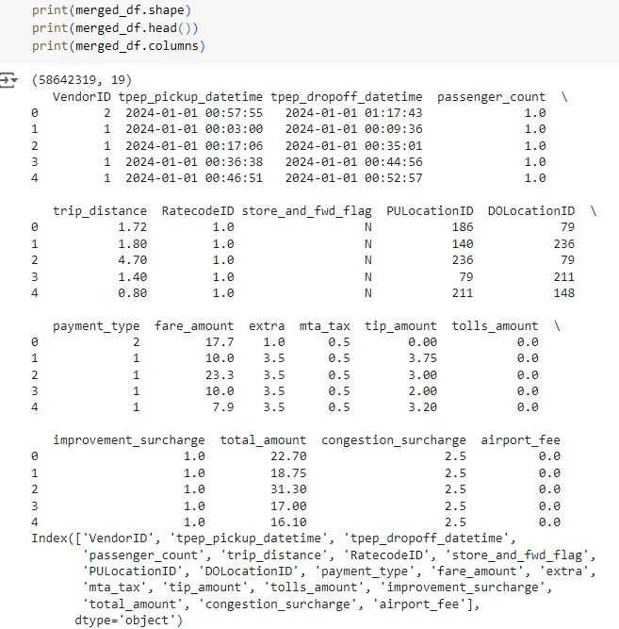
Dataset Overview
Source: NYC Taxi and Limousine Commission (TLC)
Link: https://www.nyc.gov/site/tlc/about/tlc-trip-record-data.page
Size: This dataset contains 19 columns and 58,642,319 rows, covering taxi rides from January 2023 to June 2024.
Task: Prediction (Fare, Duration) and Classification (Peak vs Off-peak hours)
Key Features:
Input Attributes: Pickup/Drop-off location (PULocationID, DOLocationID), pickup and dropoff timestamps, trip distance, passenger count, and payment type.
Target Attributes: Fare amount, trip duration, and peak/off-peak classification.
Objective: Predict taxi fares and trip durations and classify peak hours using ML models with Streamlit integration for real-time user interaction.

Slide 4
Literature Survey
Our Approach
Objective: Predict both taxi fares and trip durations with added peak/off-peak hour classification for better trip planning.
Features Added:
Peak/off-peak classification
Real-time user interaction through Streamlit
Feature Engineering - Identifying pick up and drop off location’s Latitude & longitude for trip
Model Comparison
Fare Prediction: Linear Regression, Decision trees, Random Forest and XGBoost.
Duration Prediction: Xgboost , lightgbm and Catboost Regressor
Peak Hour Classification: CatBoost Classifier
Innovation: Combines regression, classification, and interactivity via Streamlit.
Study 1: NYC Taxi Trip Duration Prediction Using MLP and XGBoost
Focus: Predict trip duration using features like pickup/drop-off times and trip distance.
Result: XGBoost outperformed MLP.
Study 2: Predicting NYC Taxi Trip Duration Using ML and Time Series Forecasting
Focus: Used temporal (time of day, day of the week) and spatial features.
Result: RNN outperformed XGBRegressor for time series forecasting.

Slide 5






Methodology Used
Data Collection
Data Cleaning
Data Preprocessing
EDA
Model Development
User Interaction
Collected data from NYC Taxi and Limousine Commission (TLC)
Removed duplicate rows.
Handled missing values by imputing or removing incomplete records.
Outlier Detection and Elimination
Normalization
Feature Engineering
Log Transformation
Encoding
Data Splitting
Drawing key insights using the existing data and creating visualization using tools like Matplot lib and Seaborn
Developed models for Taxi fare prediction, Duration prediction and also peak vs off-peak hour classification
Developed a web interface using Streamlit for effective user interaction

Slide 6
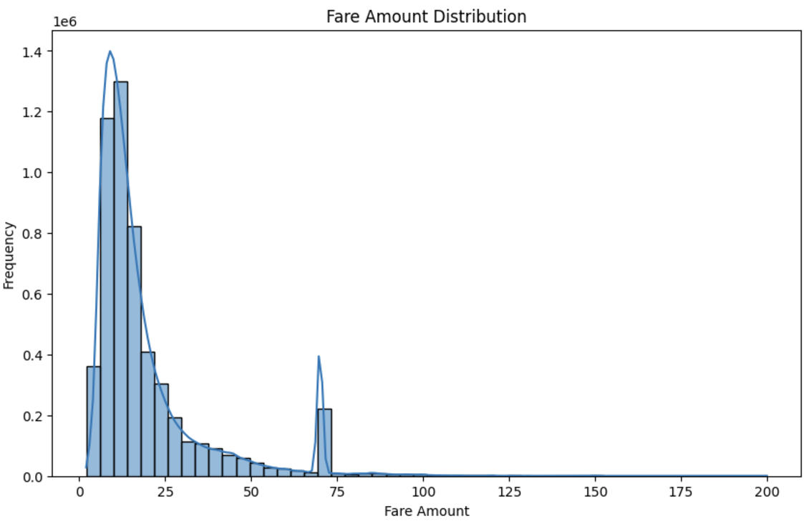
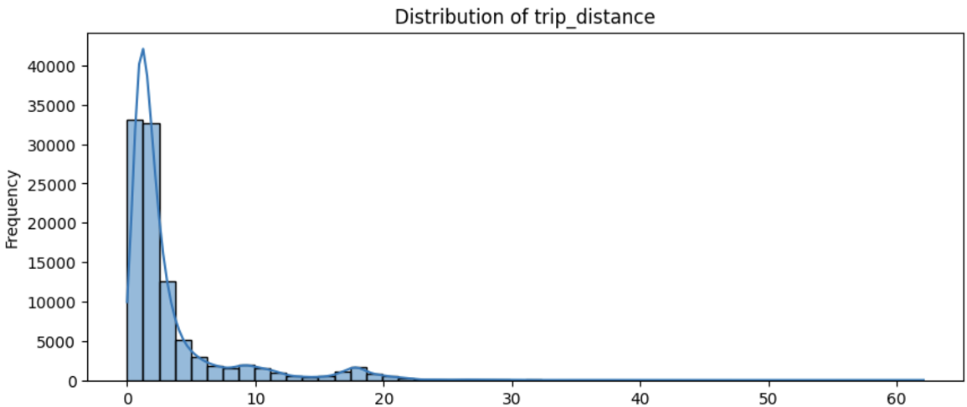
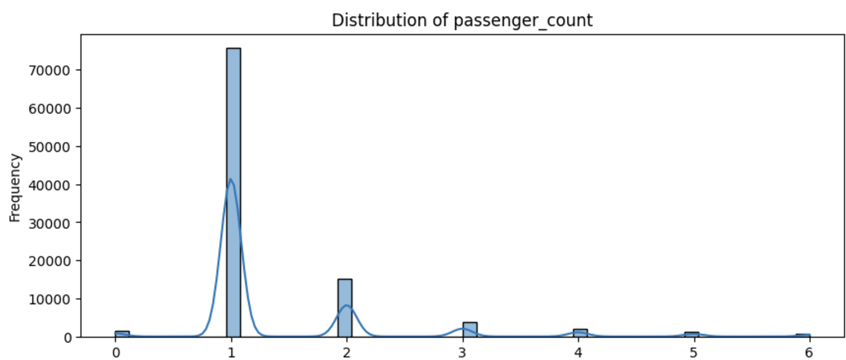
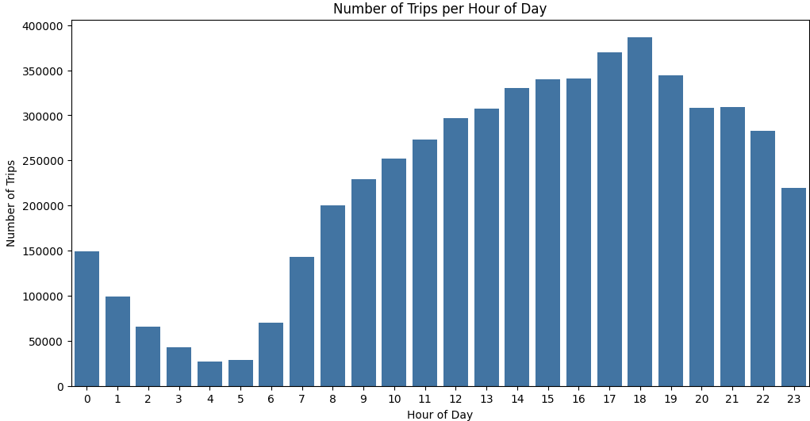
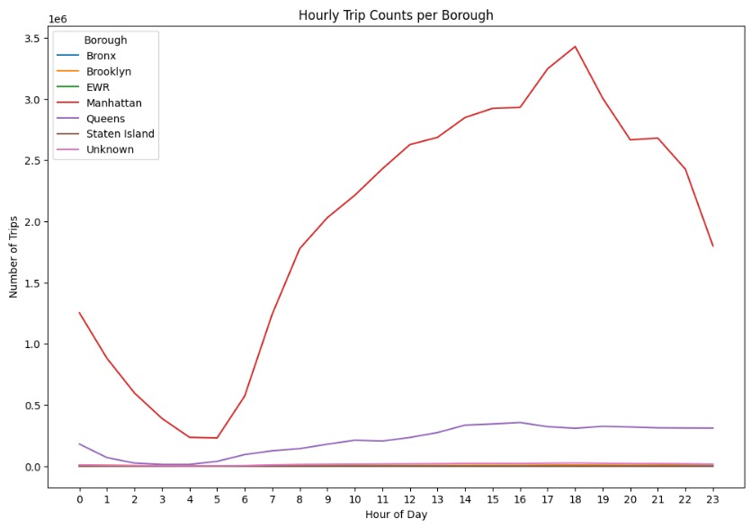
Exploratory Data Analysis

Slide 7
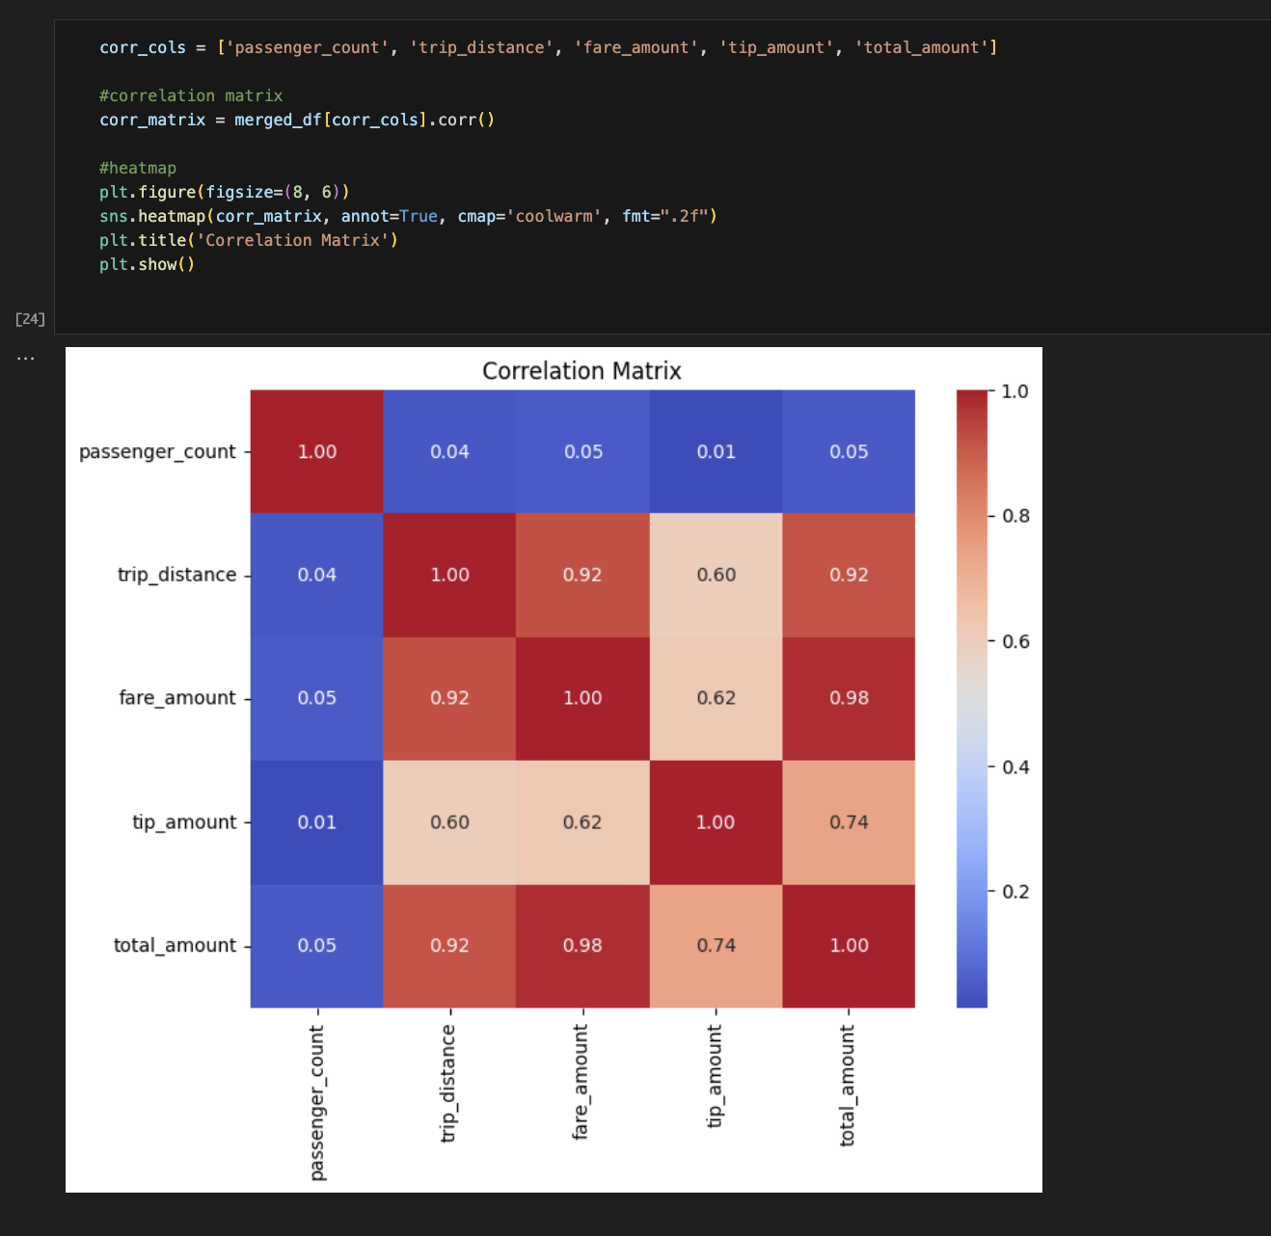
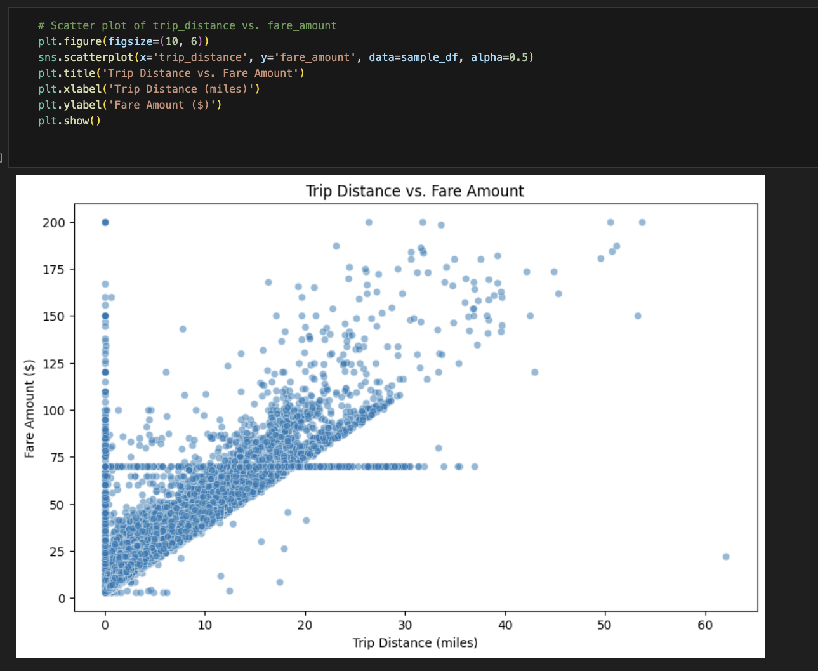
Exploratory Data Analysis
The Correlation Matrix shows a strong positive correlation (0.92) between trip distance and fare amount, indicating that longer trips generally result in higher fares.
The scatter plot reinforces this, with a clear upward trend in fare amount as trip distance increases, although some variability exists for very short trips.
This suggests that trip distance is a key predictor for fare and will be a significant feature in our model for fare prediction.

Slide 8
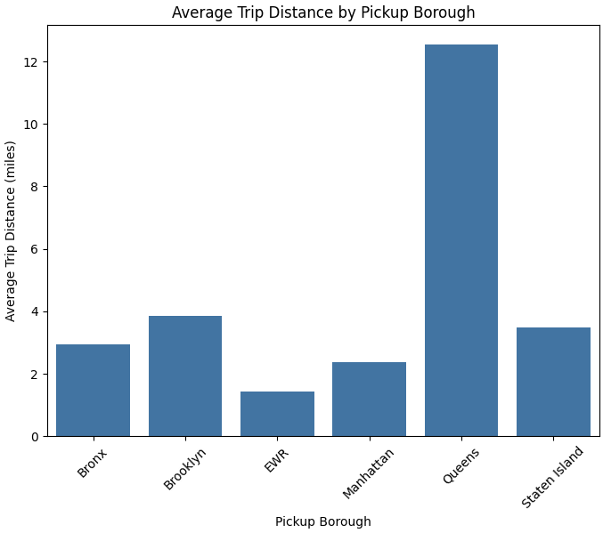
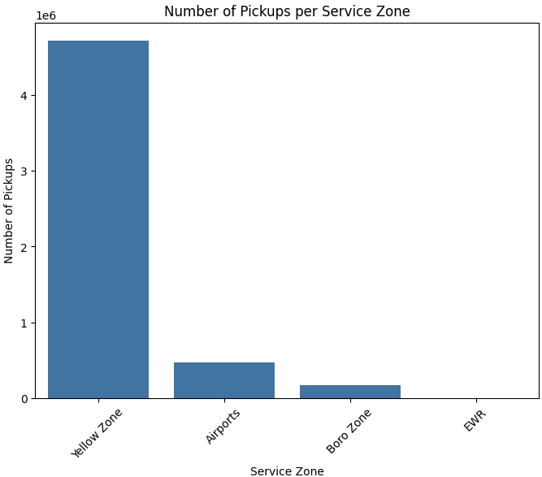
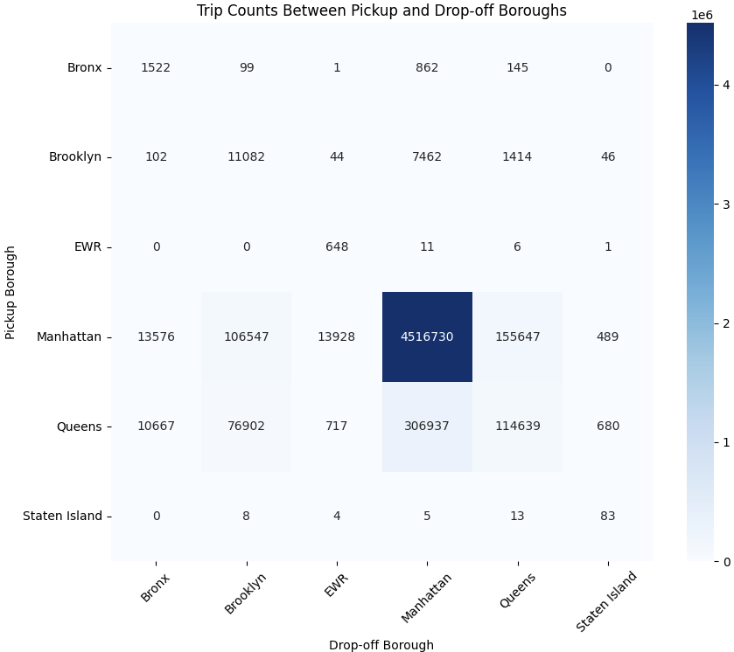
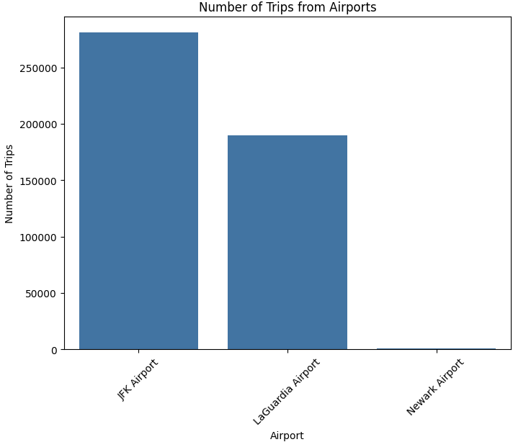
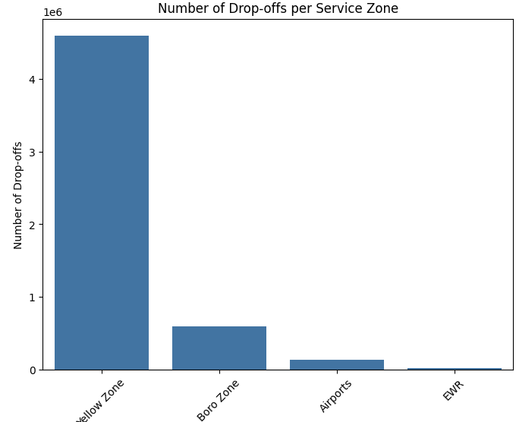
Exploratory Data Analysis

Slide 9
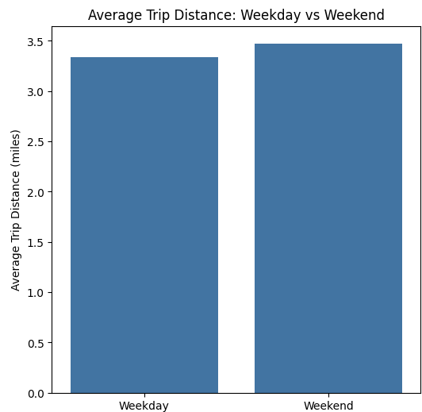
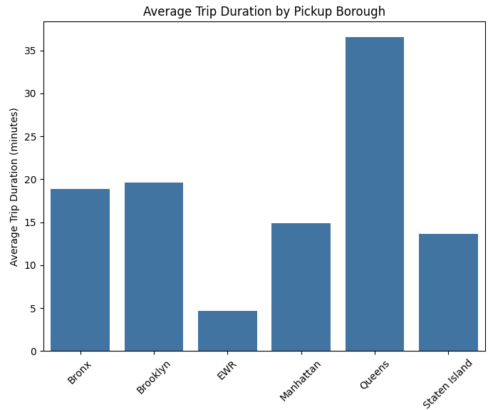
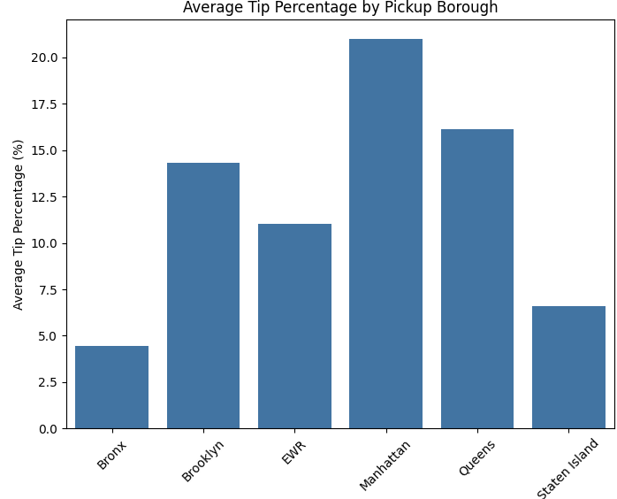
Exploratory Data Analysis

Slide 10
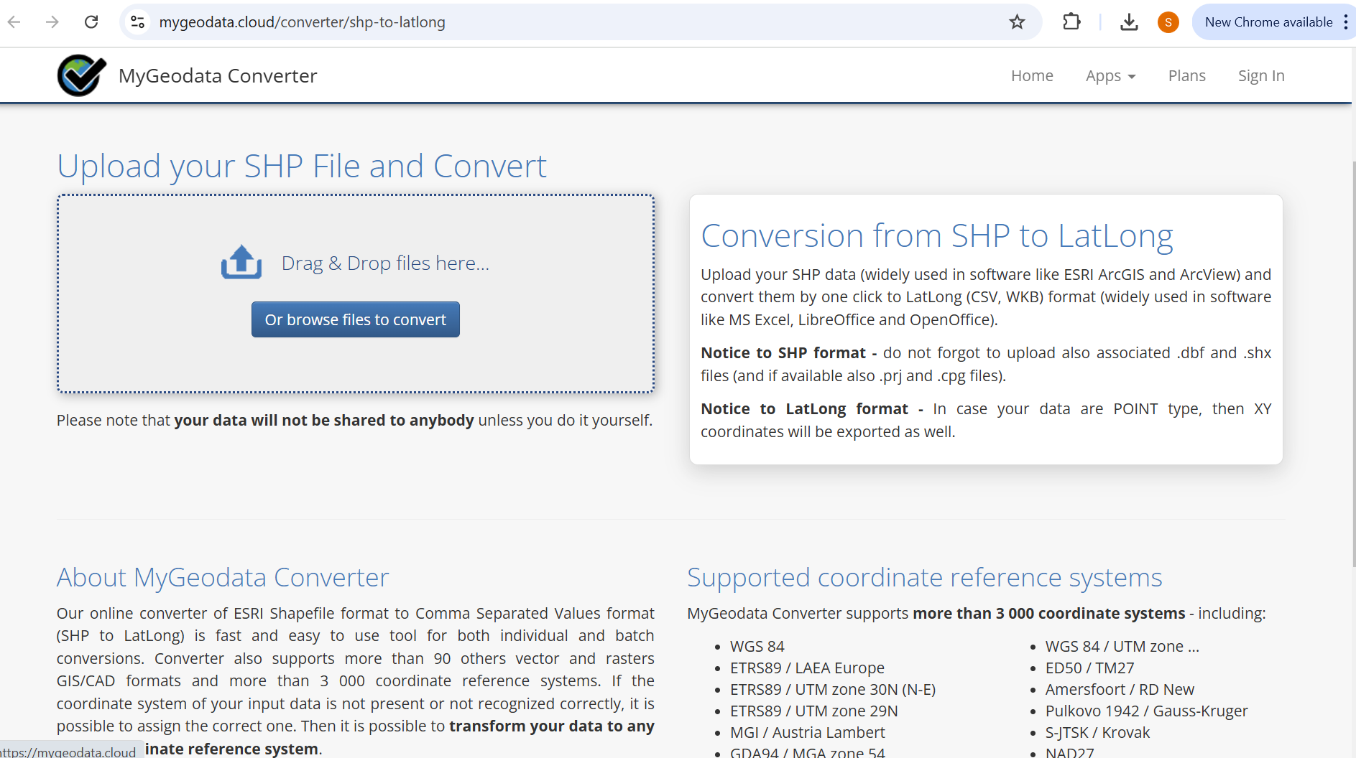
Feature Engineering
Identifying Latitude and Longitude
https://mygeodata.cloud/converter/shp-to-latlong. Referred this website for calculating latitude and longitude for the given locations

Slide 11
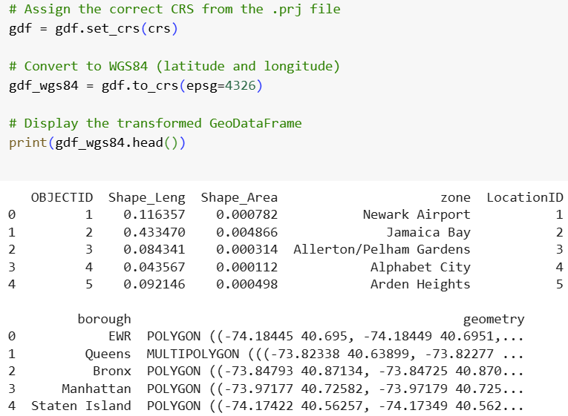
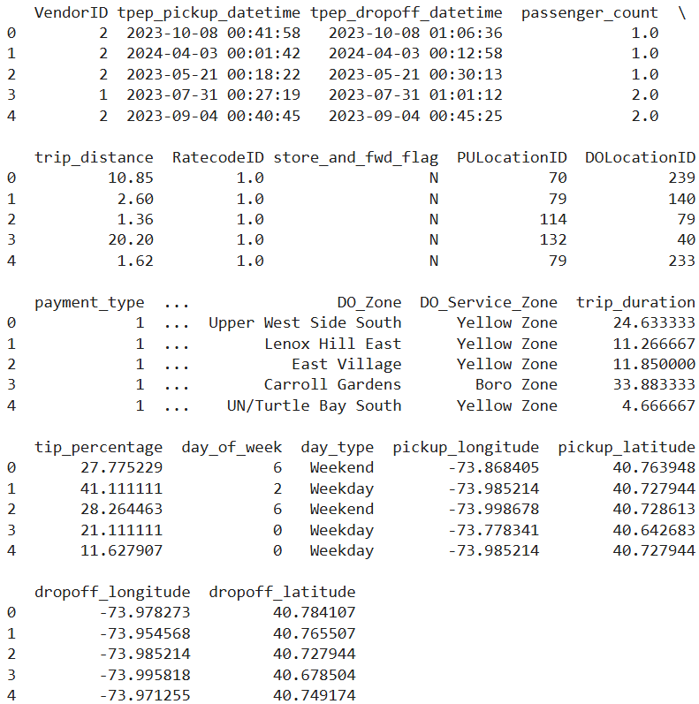
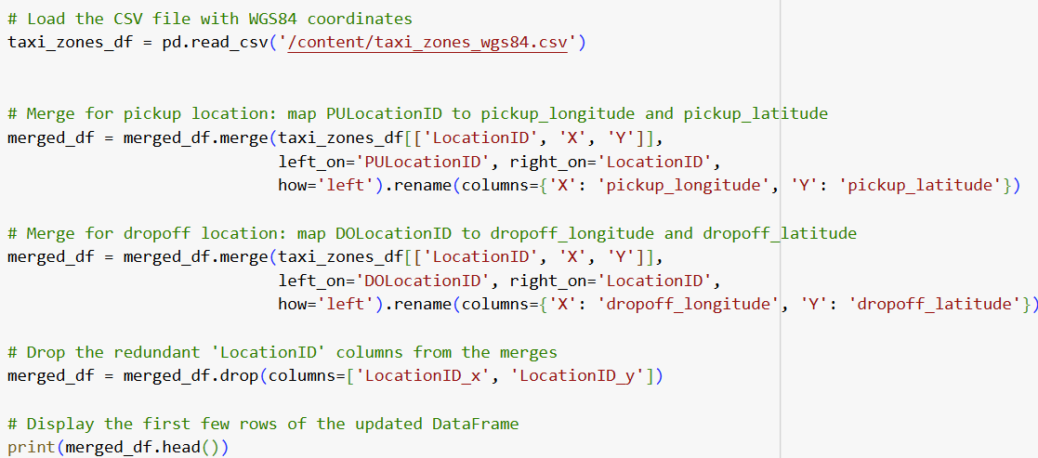
Feature Engineering
Identifying Latitude and Longitude

Slide 12
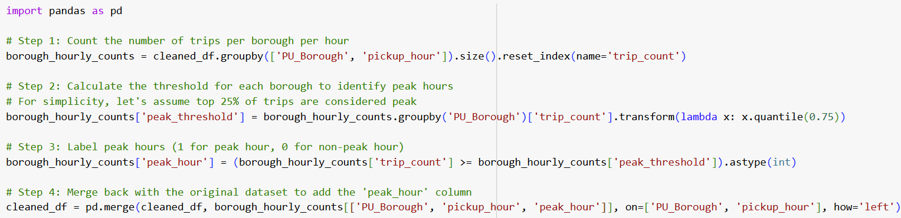
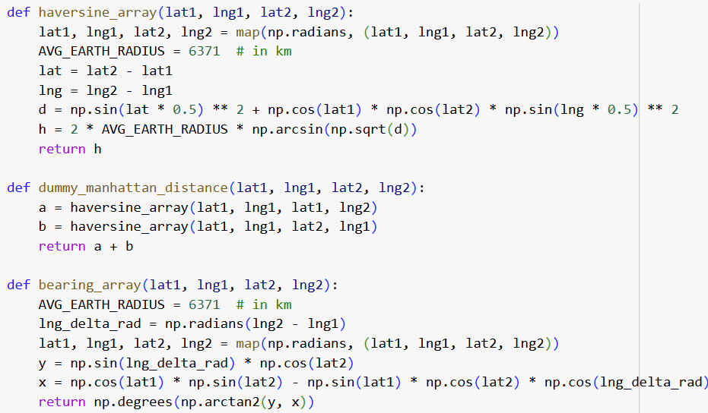
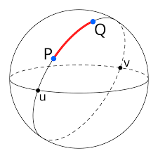
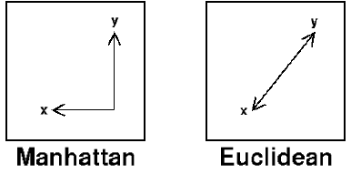
Feature Engineering
Defining Peak vs off-peak Categories
Calculating Haversine & Manhattan Distance
Calculating Average Speed
Haversine Distance
Manhattan Distance

Slide 13
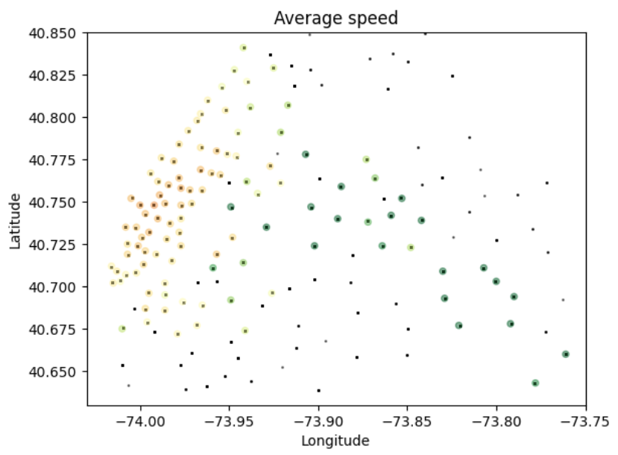
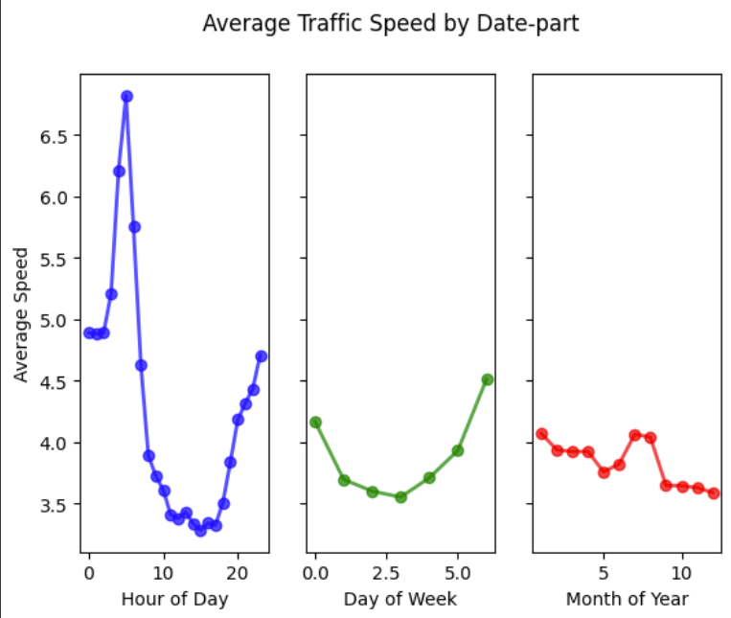
Feature Engineering
Average speed variation with location, respect to hour of day, day of week and month of year

Slide 14
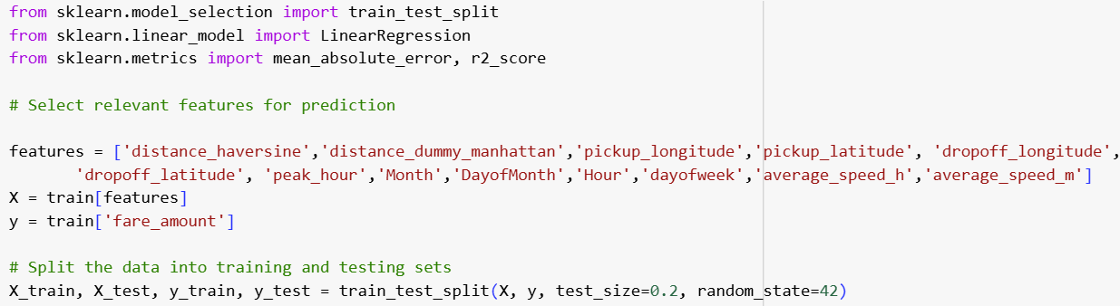
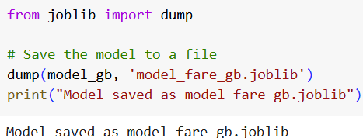
Model Development – Taxi Fare Prediction
Data Splitting
Model Comparison
Model | Mean Absolute Error (MAE) -$ | R2 Score
Linear Regression | 3.67 | 0.83
Decision Tree Regressor | 2.84 | 0.81
Gradient Boosting Regressor | 2.19 | 0.90
Random Forest Regressor | 2.27 | 0.88
Key Insights:
Random Forest Regressor performs the best with an MAE of 2.27 and R2=0.91
Gradient Boosting achieves comparable R2_Score but slightly higher MAE.
Linear Regression, while simple, does not capture non-linear patterns effectively.
So, we have chosen GB as our model and saved the same for further use

Slide 15
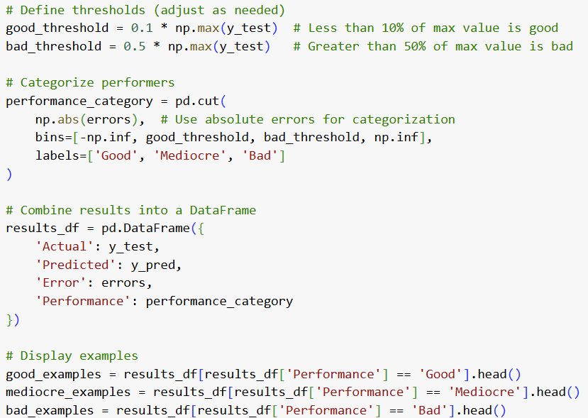
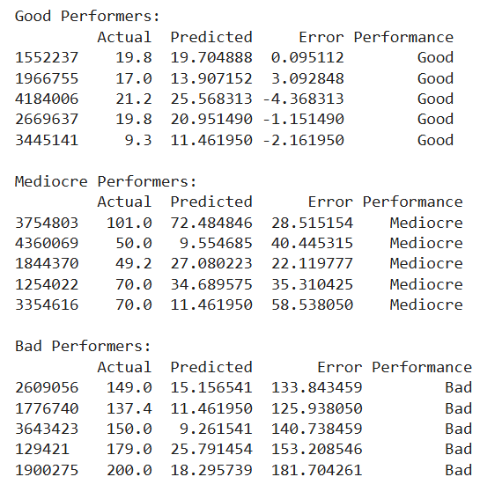
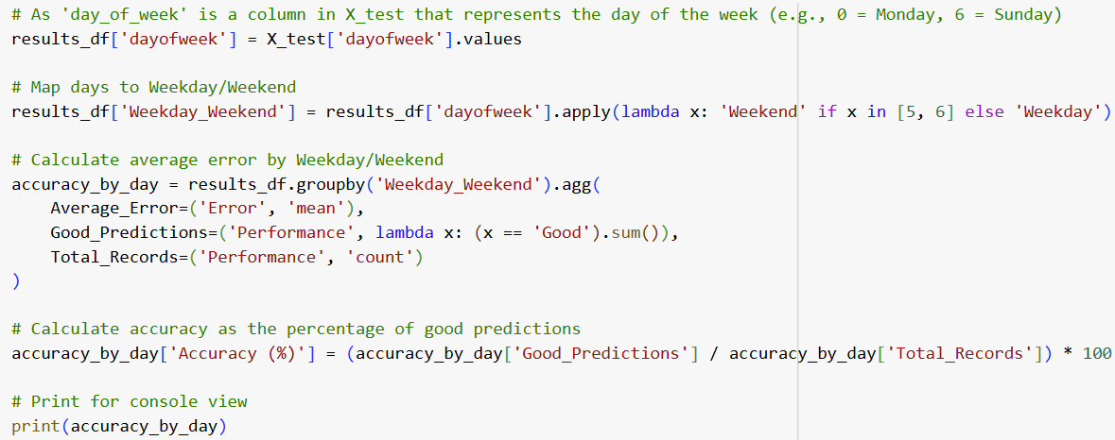
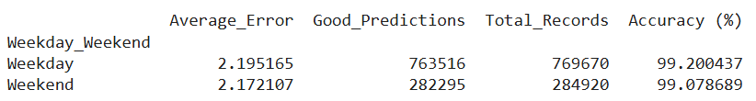
Model Development – Taxi Fare Prediction
Analysing the Predictions – Calculating good to bad performers

Slide 16
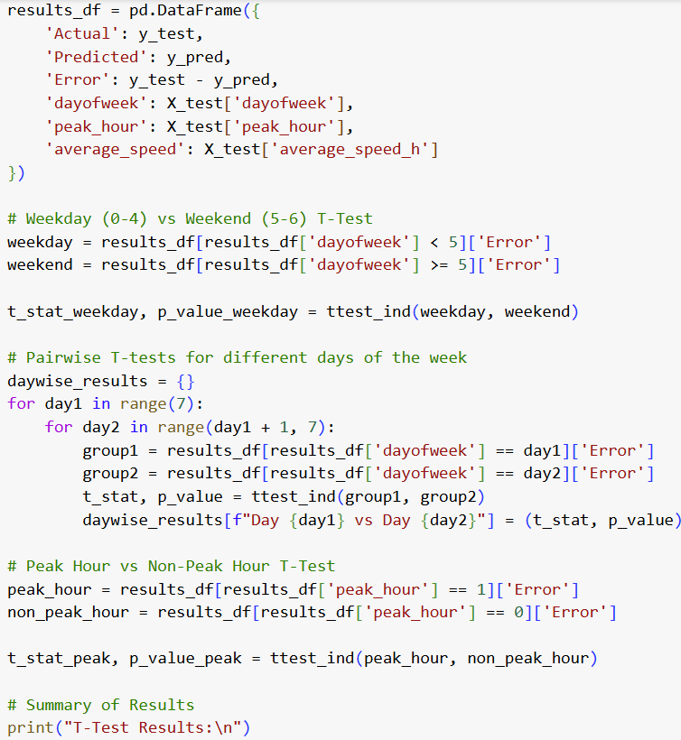
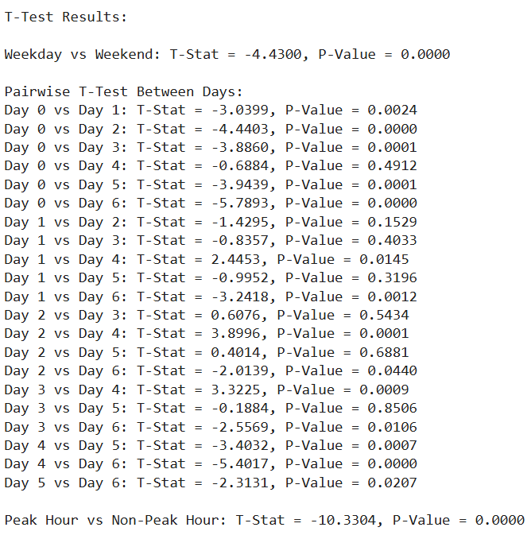
Model Development – Taxi Fare Prediction
Analysing the Predictions – Calculating T-test values

Slide 17
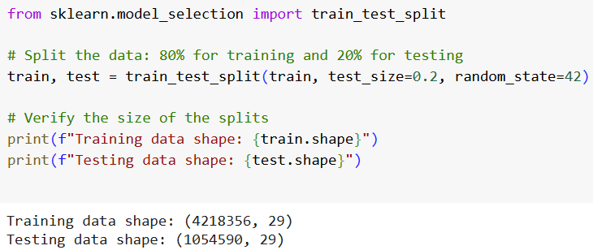
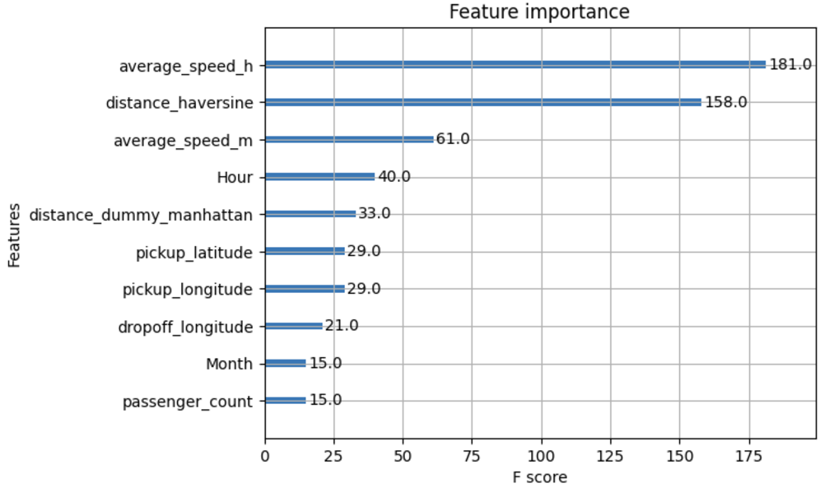
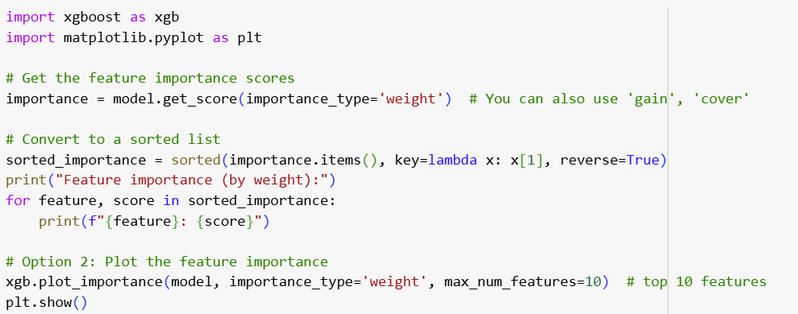
Model Development – Duration Prediction
Data Splitting
Feature Importance
Feature Importance

Slide 18
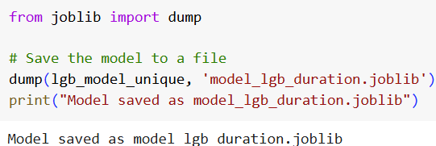
Model Development – Duration Prediction
Key Insights:
Lightgbm performs the best with an MAE of 0.15 and R2=0.84
Other models interms of decreasing performance order are: Xgboost, Decision tree and Linear regressor
Close performance to LightGBM with slight differences in error metrics. Requires longer training times but works well for small datasets.
Model Comparison
Model | Mean Absolute Error (MAE) | R2 Score
Linear Regressor | 0.41 | 0.49
Xgboost | 0.16 | 0.83
DecisionTree Regressor | 0.23 | 0.64
Lightgbm | 0.15 | 0.84
So, we have chosen lightgbm as our model and saved the same for further use

Slide 19
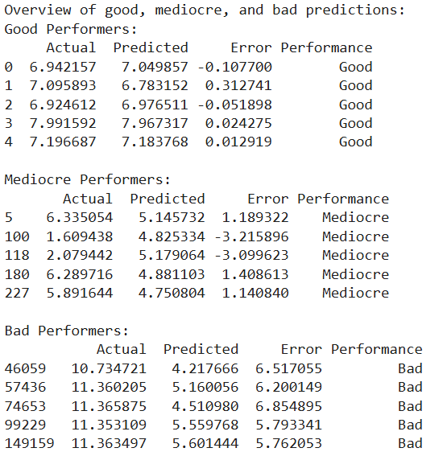
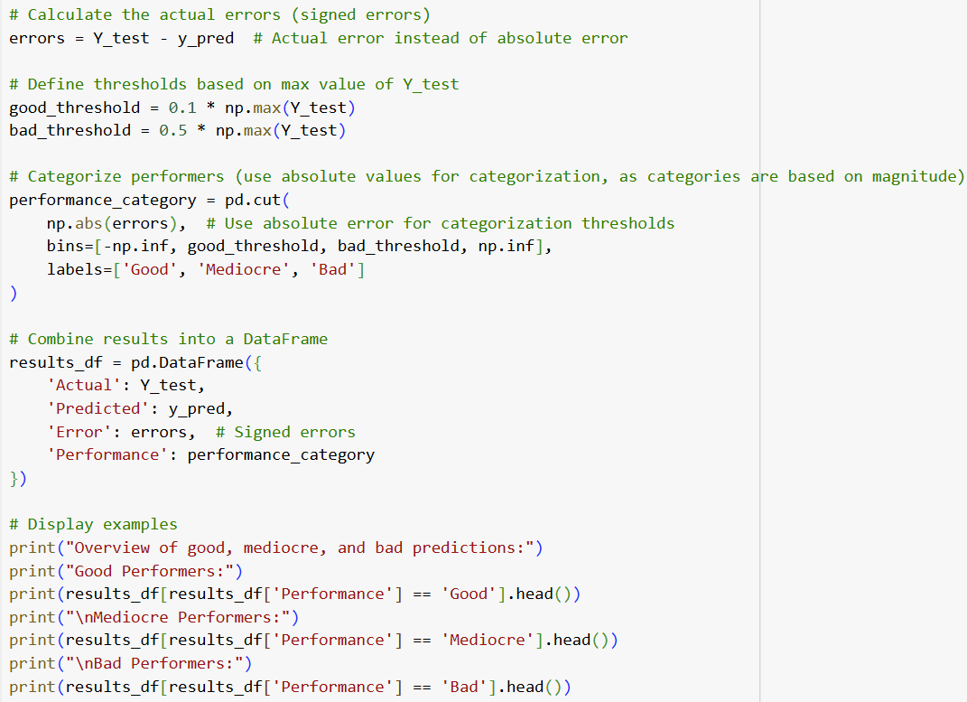
Model Development – Duration Prediction
output in log (secs)
Analysing the Predictions – Calculating good to bad performers

Slide 20
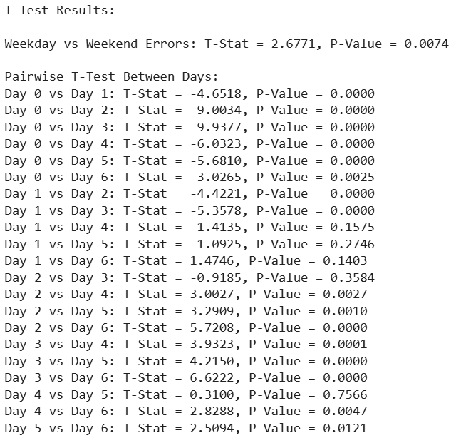
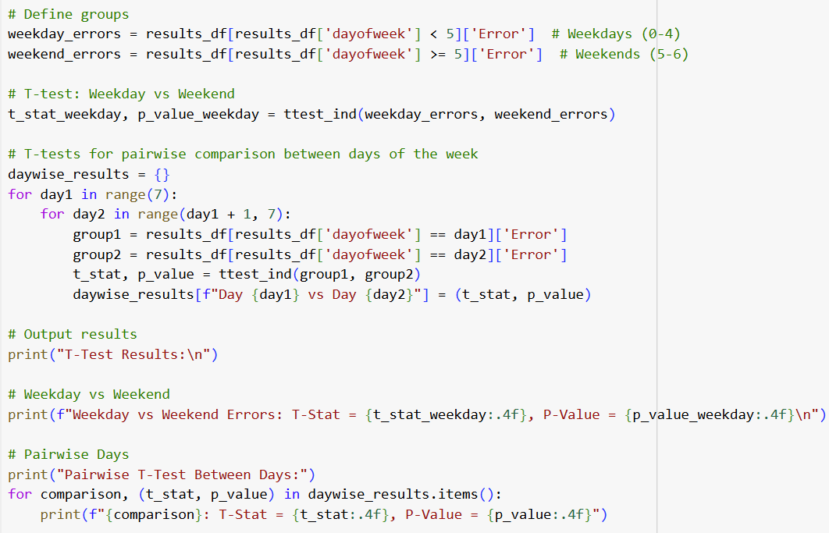
Model Development –Duration Prediction
Analysing the Predictions – Calculating T-test values

Slide 21
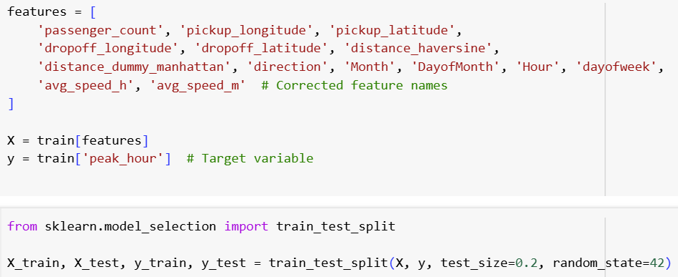
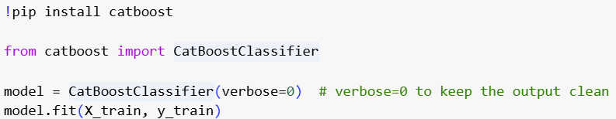
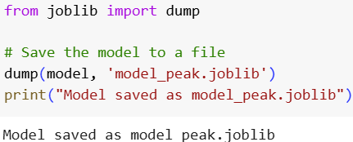
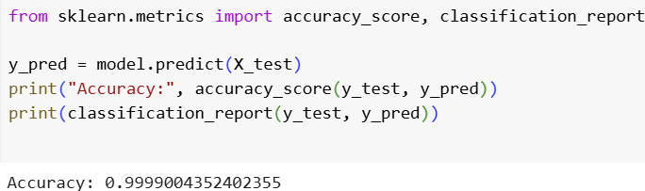
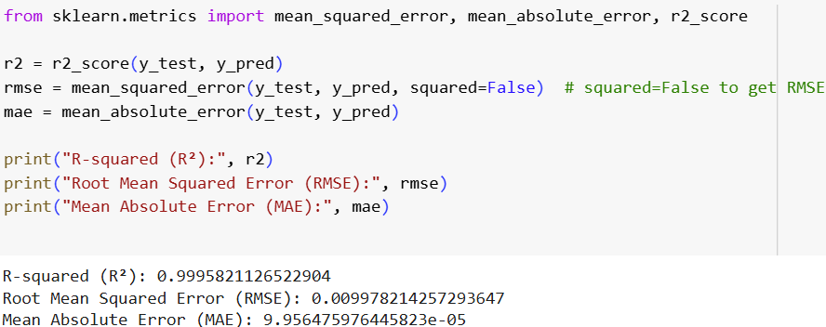
Model Development – Peak Vs off peak hour Classification
Data Splitting
Model
Results

Slide 22

User Interface
Streamlit is an open-source Python library for quickly creating interactive web apps from Python scripts. Ideal for machine learning, data analysis, and visualization, it simplifies building apps with intuitive syntax, real-time updates, and seamless integration of user inputs and dynamic outputs.
Applications
Data Exploration
Machine Learning Models
Business Applications
Educational Tools

Slide 23
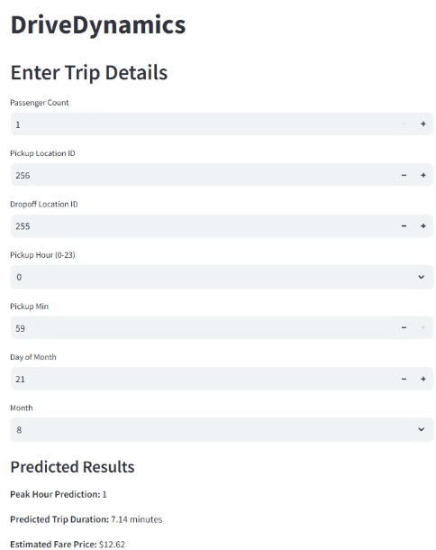
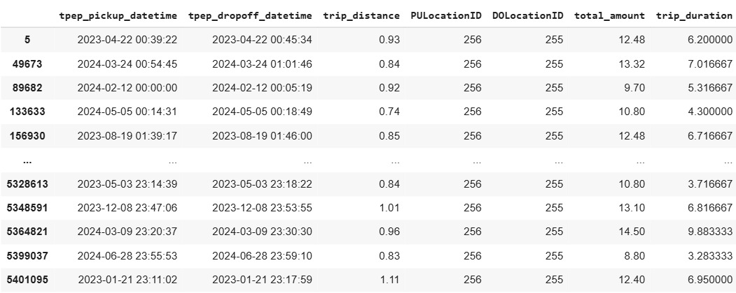
User Interface -: Streamlit Snapshots
Taxi Zone: Snapshot
LocationID | Borough | Zone | service_zone
79 | Manhattan | East Village | Yellow Zone
140 | Manhattan | Lenox Hill East | Yellow Zone
235 | Bronx | University Heights/Morris Heights | Boro Zone
236 | Manhattan | Upper East Side North | Yellow Zone
255 | Brooklyn | Williamsburg (North Side) | Boro Zone
256 | Brooklyn | Williamsburg (South Side) | Boro Zone
262 | Manhattan | Yorkville East | Yellow Zone
Validating the output with existing data
Peak Hour
0 : Off Peak
1 : Peak Hour

Slide 24


User Interface -: Streamlit Snapshots
Taxi Zone: Snapshot
LocationID | Borough | Zone | service_zone
79 | Manhattan | East Village | Yellow Zone
140 | Manhattan | Lenox Hill East | Yellow Zone
235 | Bronx | University Heights/Morris Heights | Boro Zone
236 | Manhattan | Upper East Side North | Yellow Zone
255 | Brooklyn | Williamsburg (North Side) | Boro Zone
256 | Brooklyn | Williamsburg (South Side) | Boro Zone
262 | Manhattan | Yorkville East | Yellow Zone
Validating the output with existing data
Peak Hour
0 : Off Peak
1 : Peak Hour

Slide 25
Conclusion
Feature Engineering:
Key features such as distance_haversine, distance_dummy_manhattan, and peak_hour were created to enhance the model's ability to capture complex relationships.
Grouped metrics like average speeds (avg_speed_h and avg_speed_m) provided deeper insights into travel patterns.
Successfully deployed models including advanced ones like Catboost, Xgboost etc for
Taxi Fare preduction
Duration Prediction
Peak Vs Off-Peak hour classification
Integrated Streamlit with the high-performance models for effective user interface making it easier
Calculated T-test values to gather the insights from data

Slide 26

Way Forward
Adding real time data like weather , traffic and event data can give accurate results.
Hyperparameter tuning can be explored to further improve the accuracy of models.
We can also consider integrating environmental data into the analysis. For instance, how might traffic patterns affect carbon emissions or fuel consumption during peak hours aiming towards sustainable planet.

Slide 27
References
https://www.nyc.gov/site/tlc/about/tlc-trip-record-data.page
Poongodi, M., Malviya, M., Kumar, C. et al. New York City taxi trip duration prediction using MLP and XGBoost. Int J Syst Assur Eng Manag 13 (Suppl 1), 16–27 (2022). https://doi.org/10.1007/s13198-021-01130-x
Ramani, S., Ghiya, A., Aravind, P.S., Karuppiah, M., Pelusi, D. (2022). Predicting New York Taxi Trip Duration Based on Regression Analysis Using ML and Time Series Forecasting Using DL. In: Raj, J.S., Shi, Y., Pelusi, D., Balas, V.E. (eds) Intelligent Sustainable Systems. Lecture Notes in Networks and Systems, vol 458. Springer, Singapore. https://doi.org/10.1007/978-981-19-2894-9_2
Referred the below website for calculating latitude and longitude.
https://mygeodata.cloud/converter/shp-to-latlong

Slide 28
THANK YOU

